Slide 1

Extending Share: from the outside in
David Webster
April 2016

Slide 2
Extending Share: from the outside in
David Webster
April 2016

Slide 3
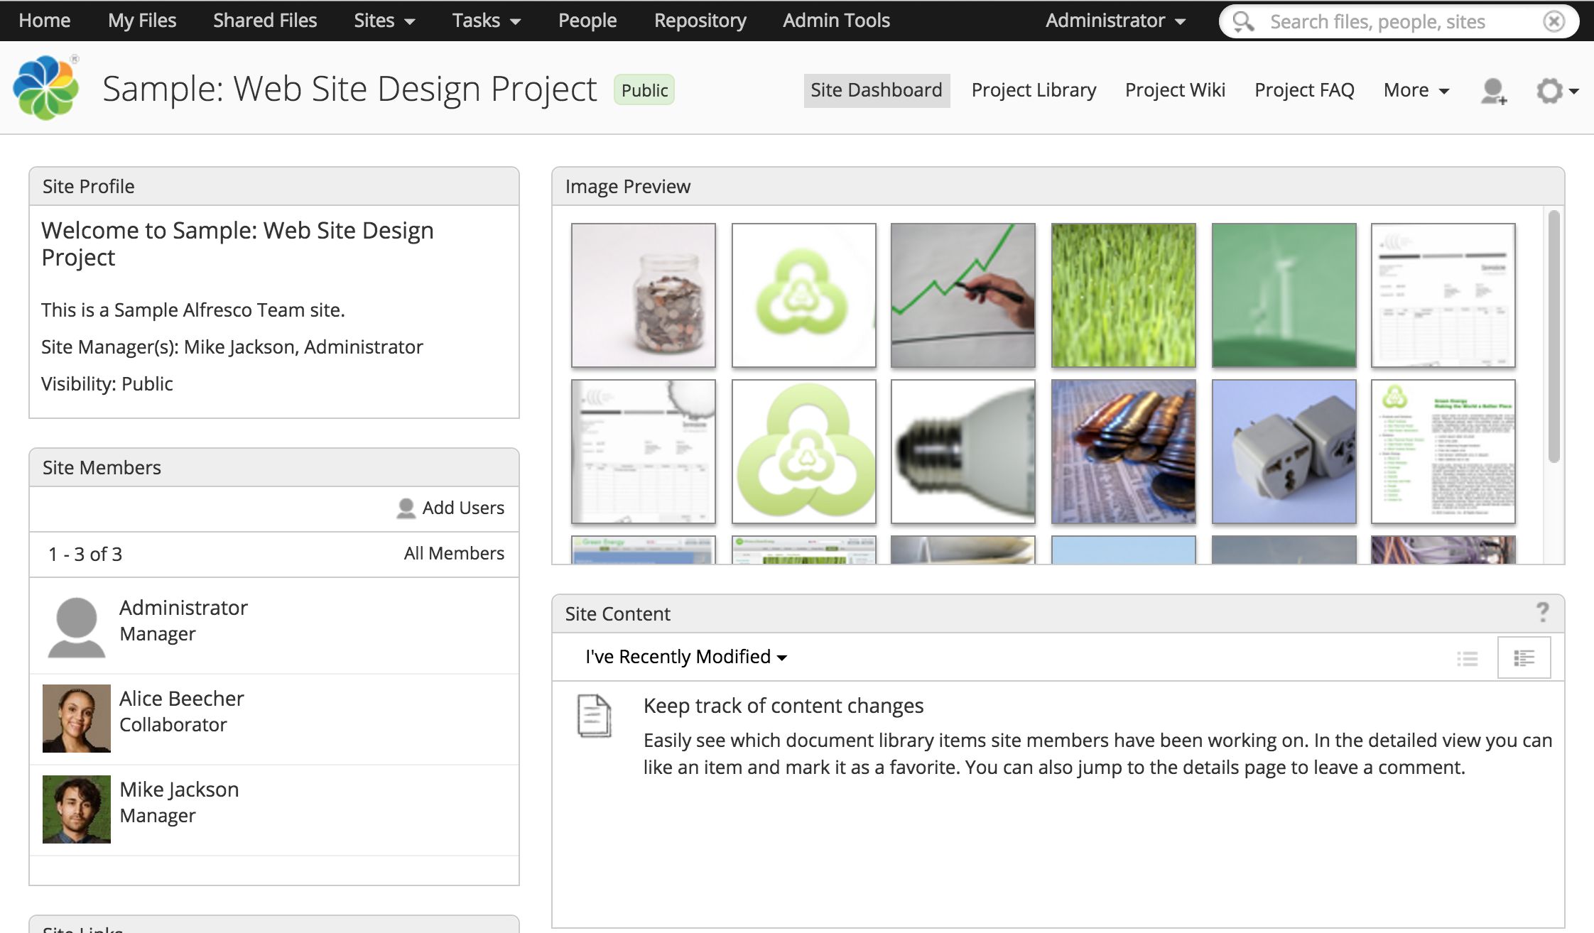
Alfresco Share

Slide 4

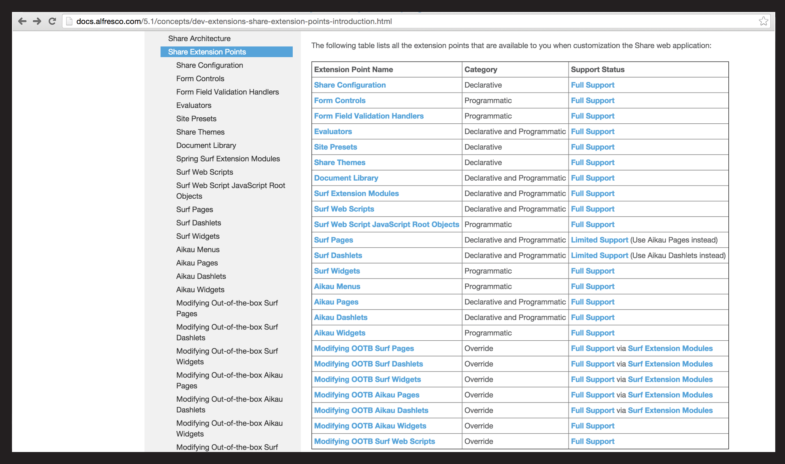

Slide 5
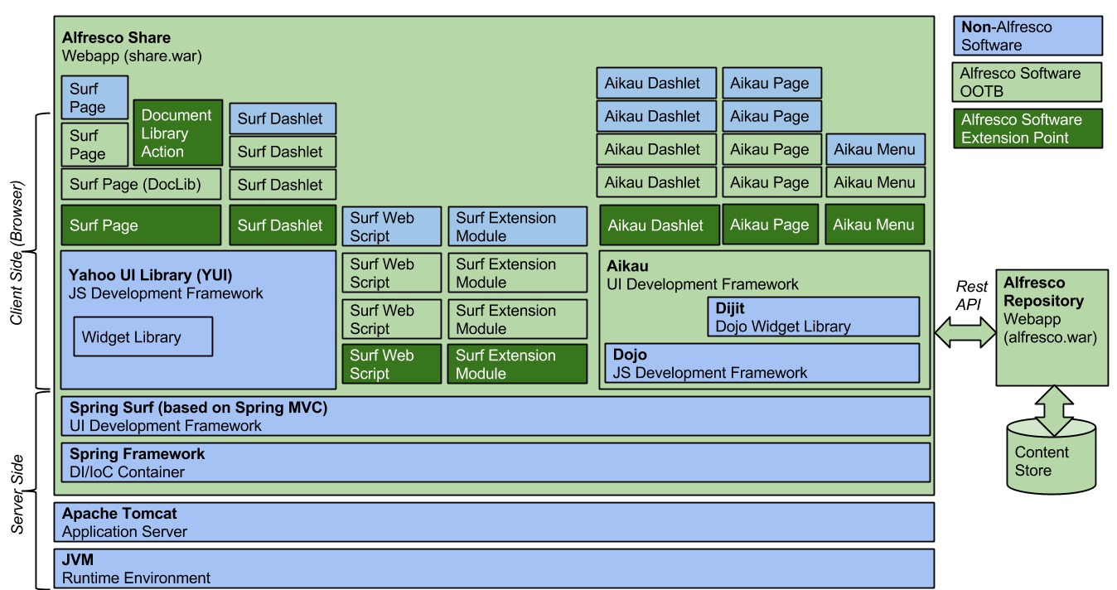

Slide 7
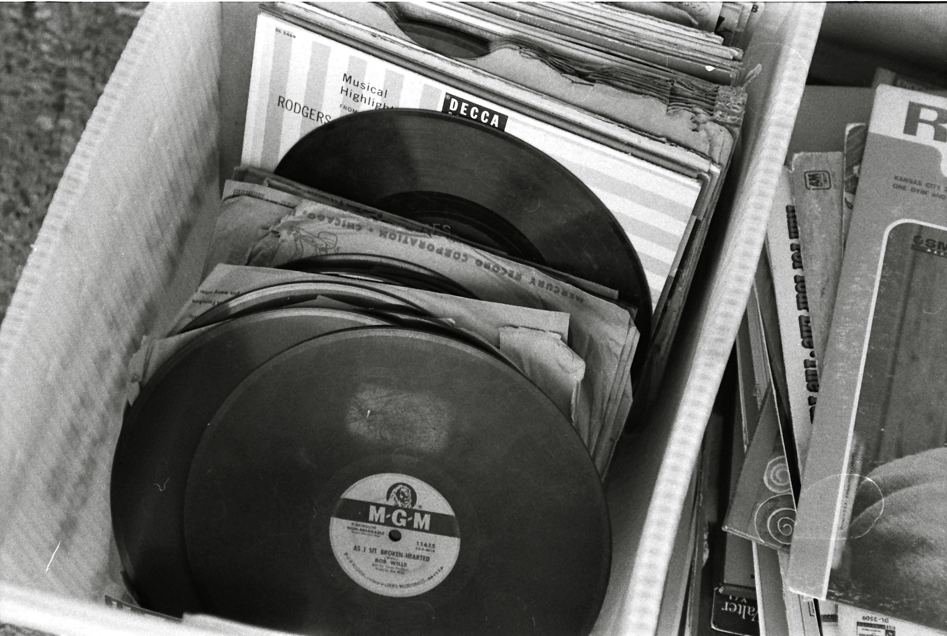
Records Management Module
Image: https://www.flickr.com/photos/stevensnodgrass/6644713363

Slide 8
RM Extensions
Surf Extension Modules
Module deployment page
Resources WebScript
Common JS code and Alfresco.constants
Create Site Dialog
Custom site type
Document Library
Metadata Templates
Actions and Evaluators
Faceted Search
API & Aikau widget
Document Details
Add relationship feature

Slide 9
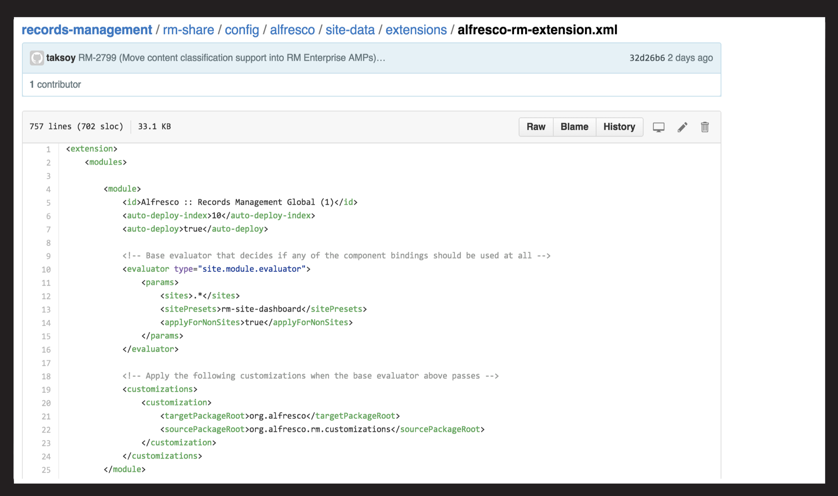

Slide 10
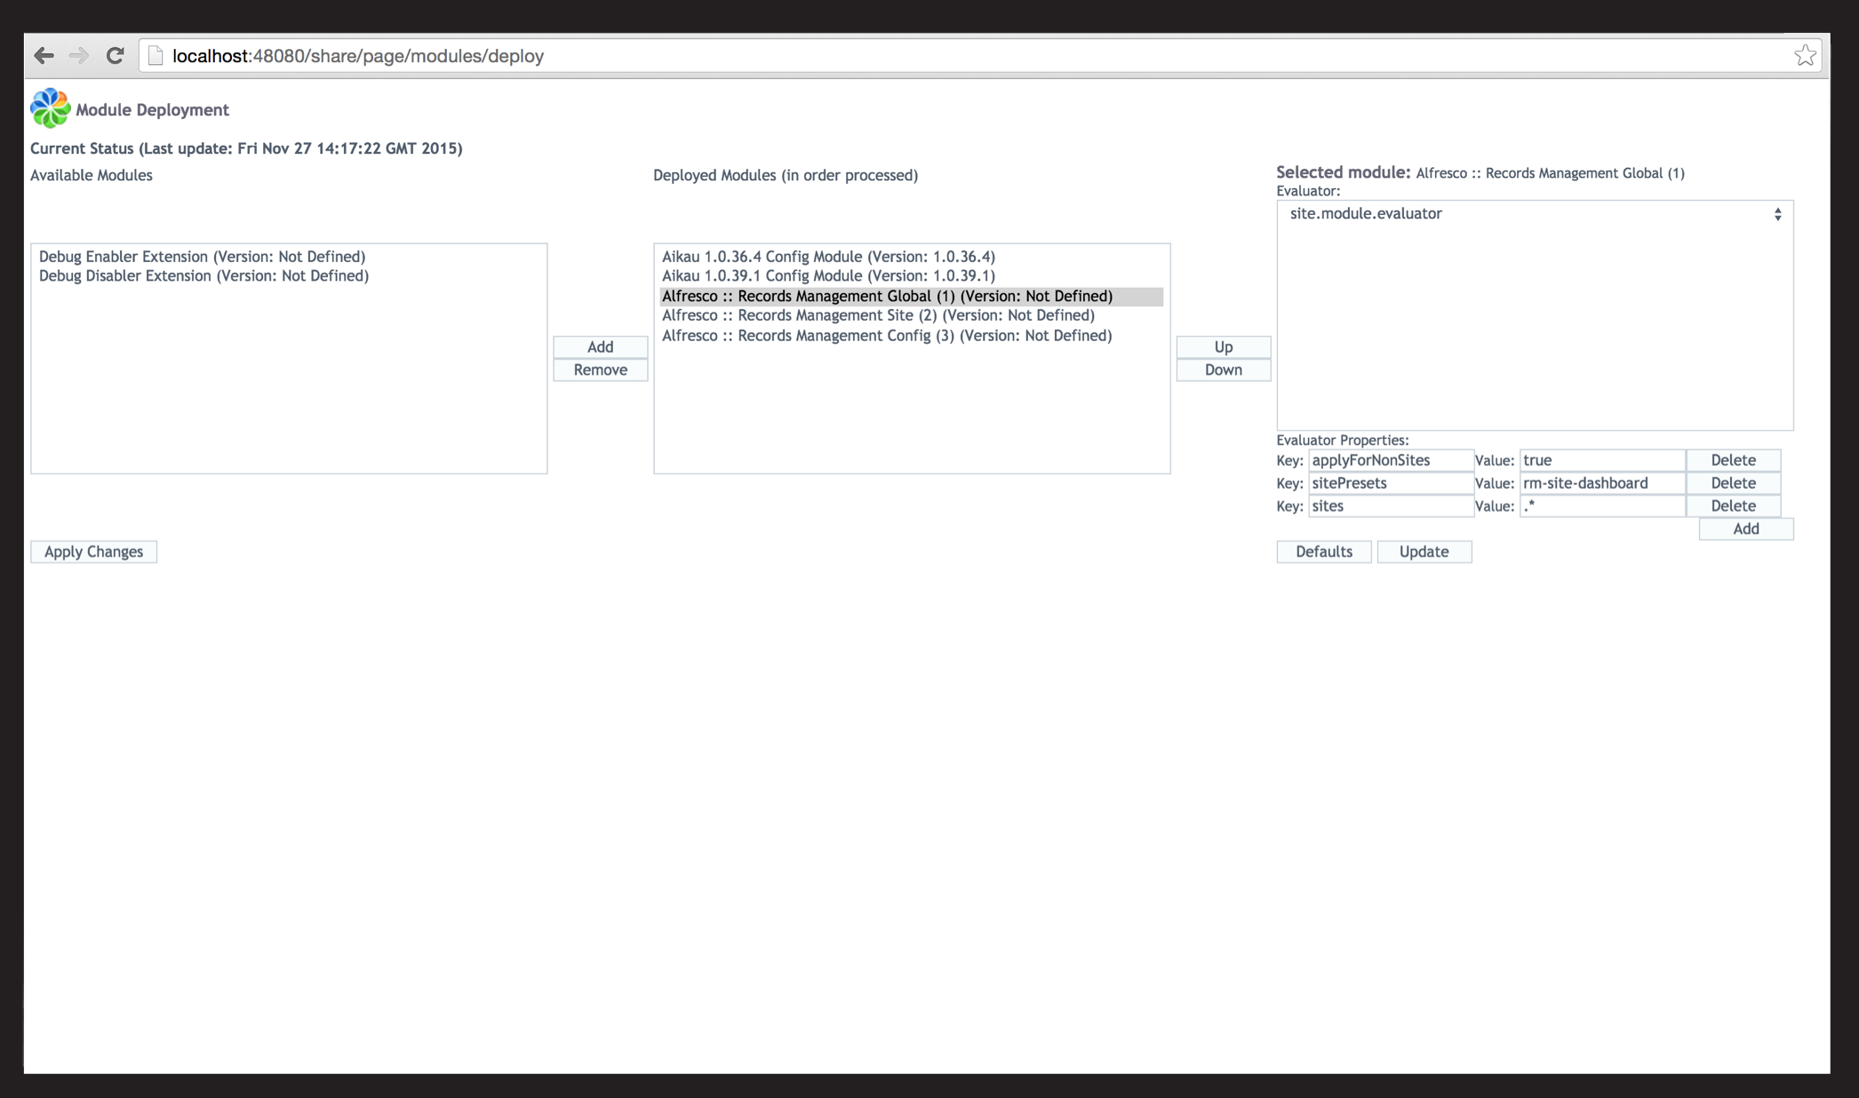

Slide 11
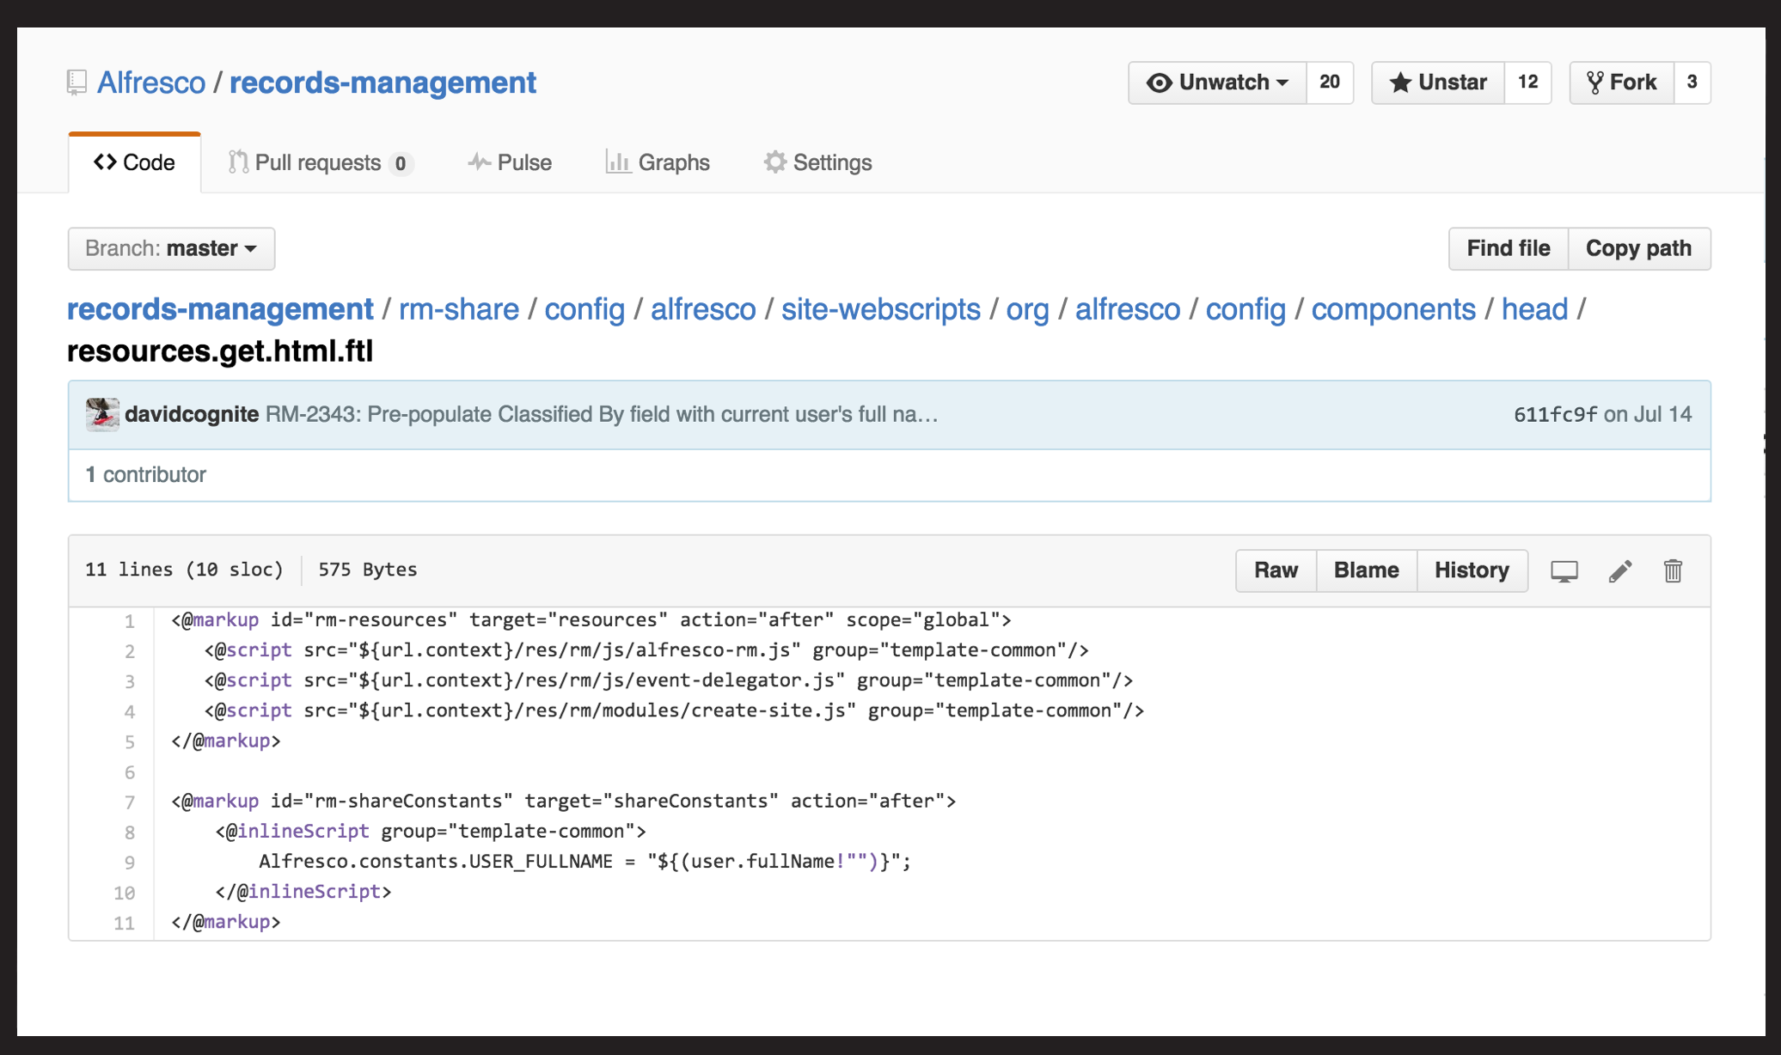

Slide 12
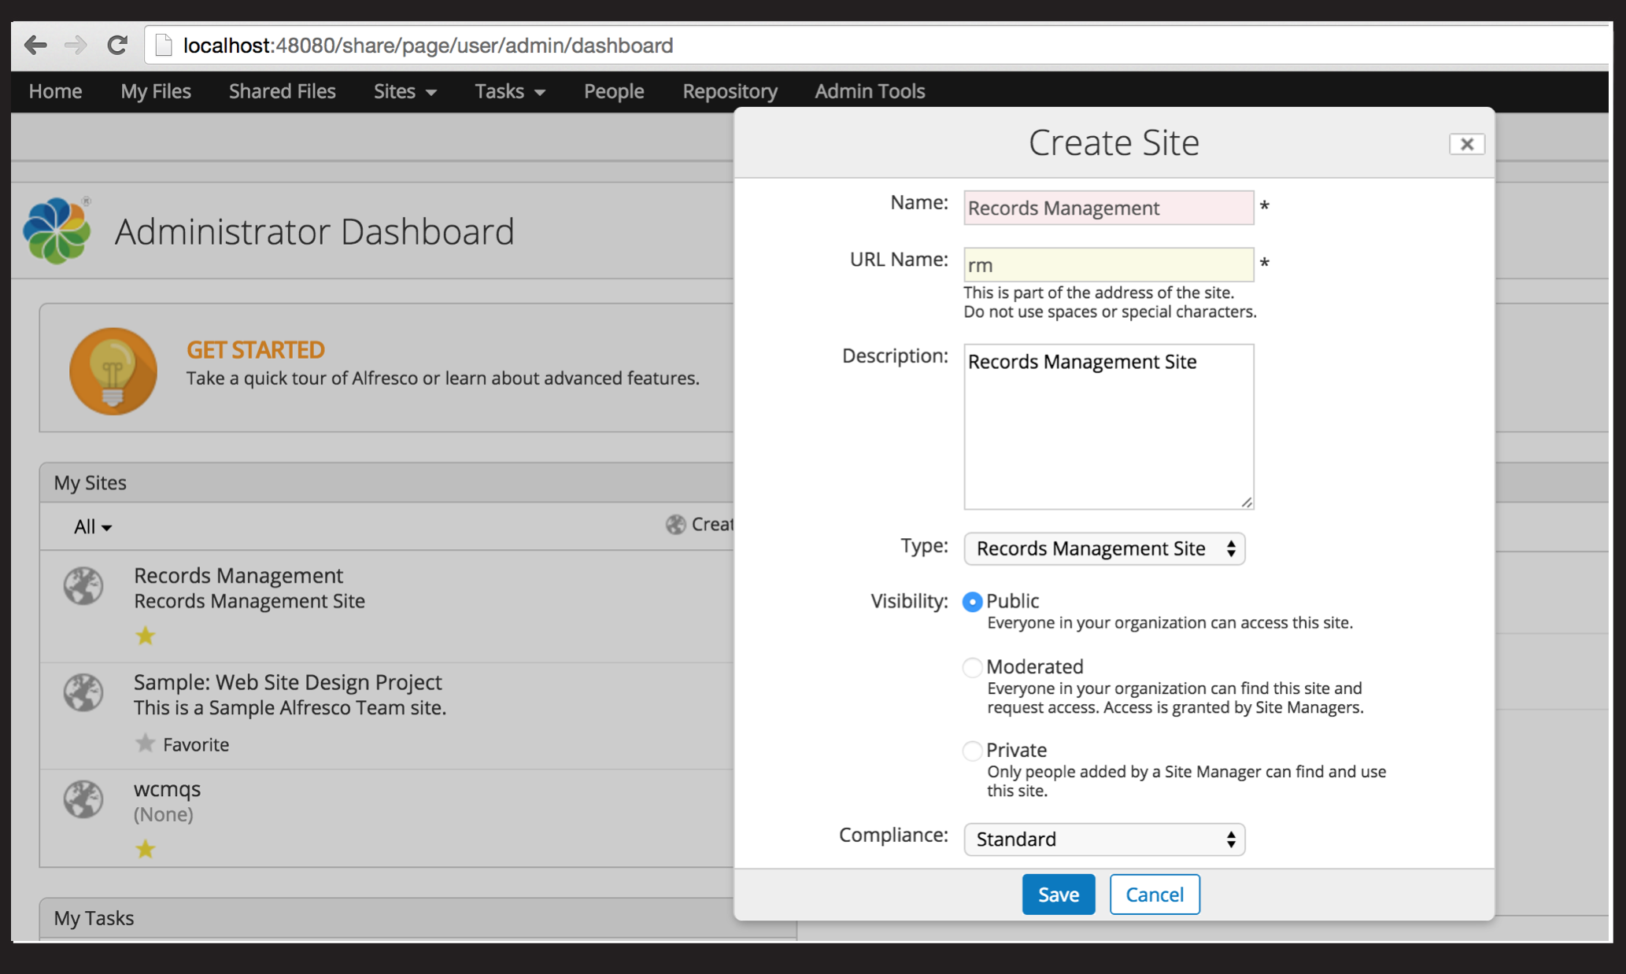

Slide 13
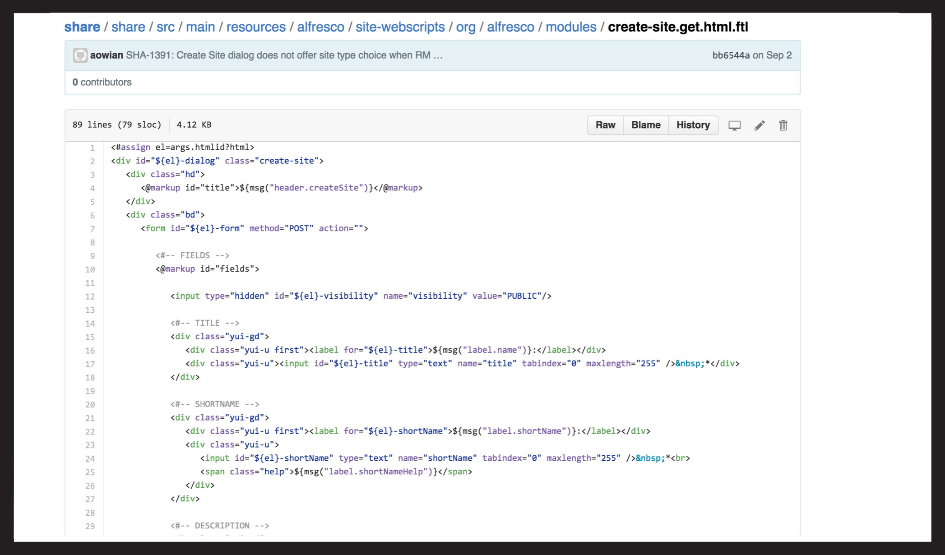

Slide 14
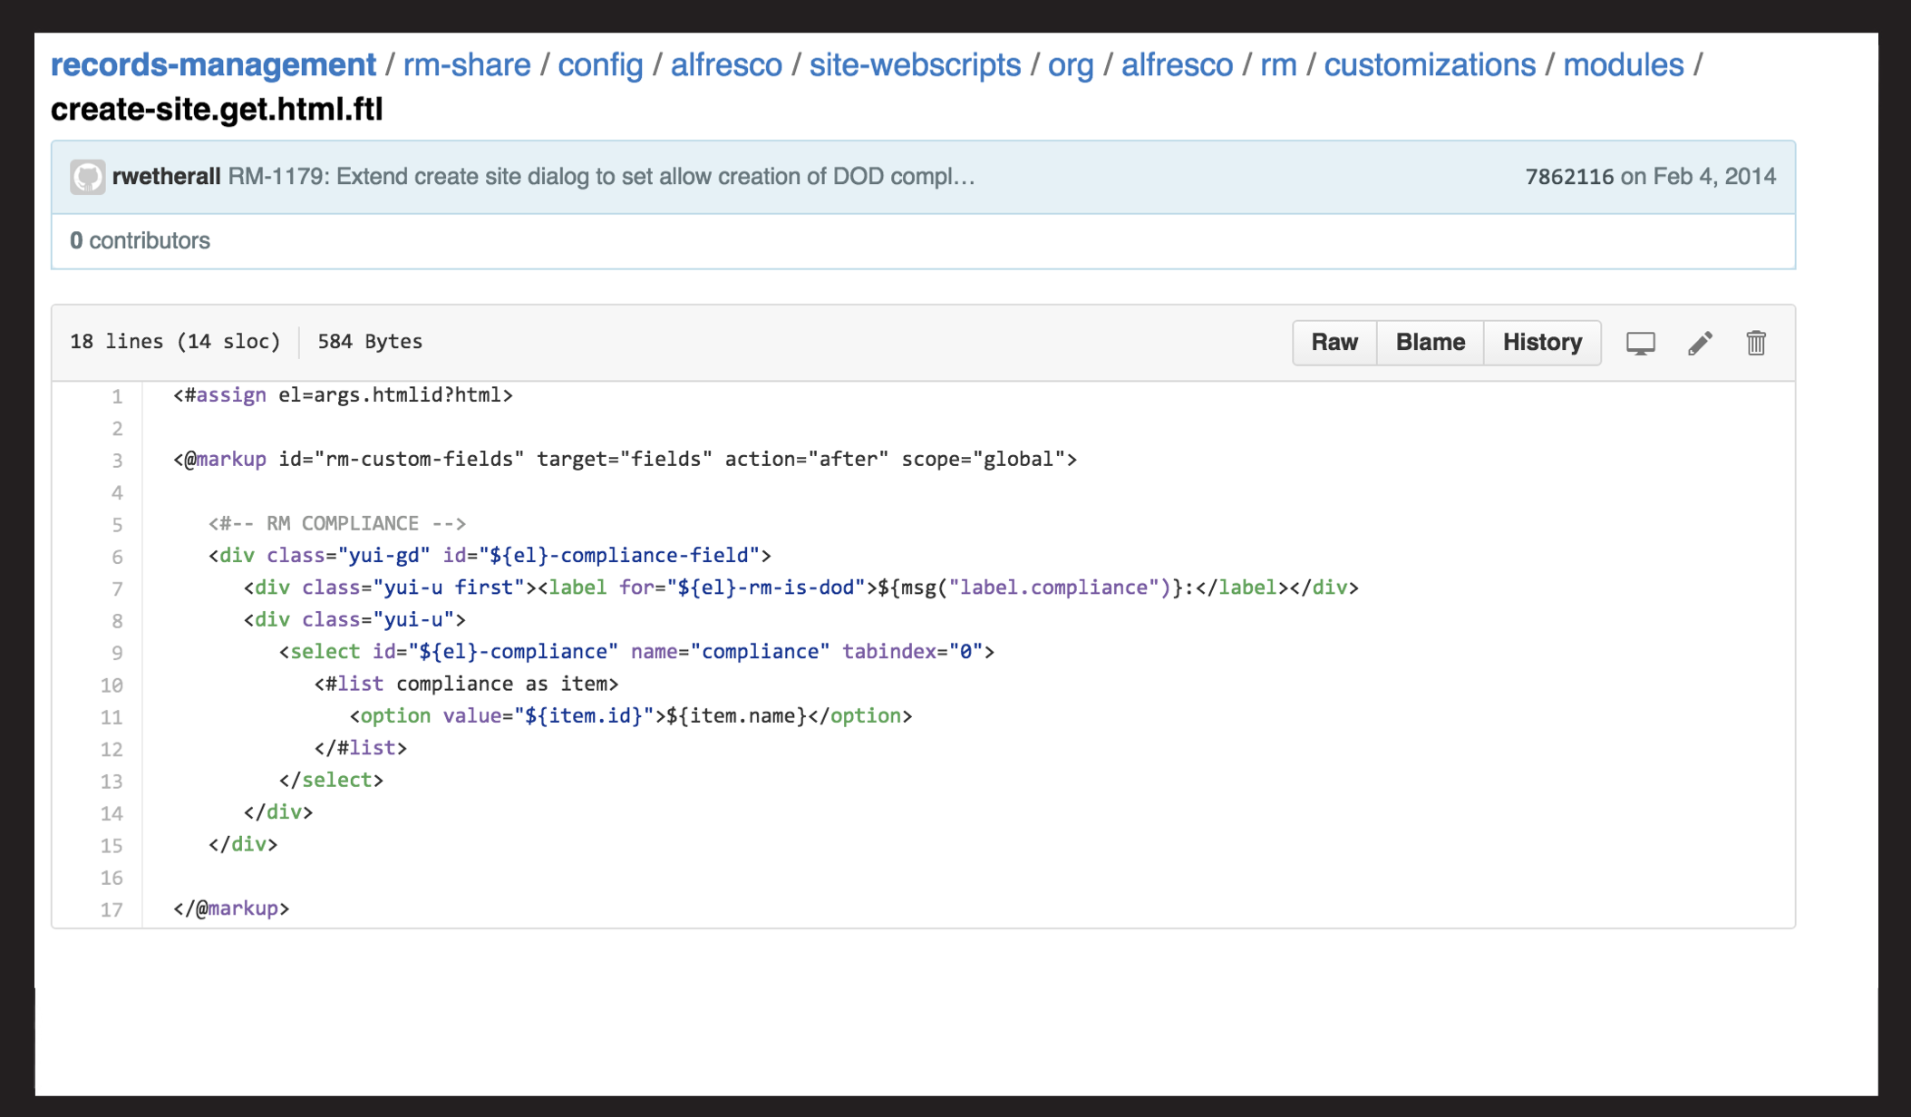

Slide 15
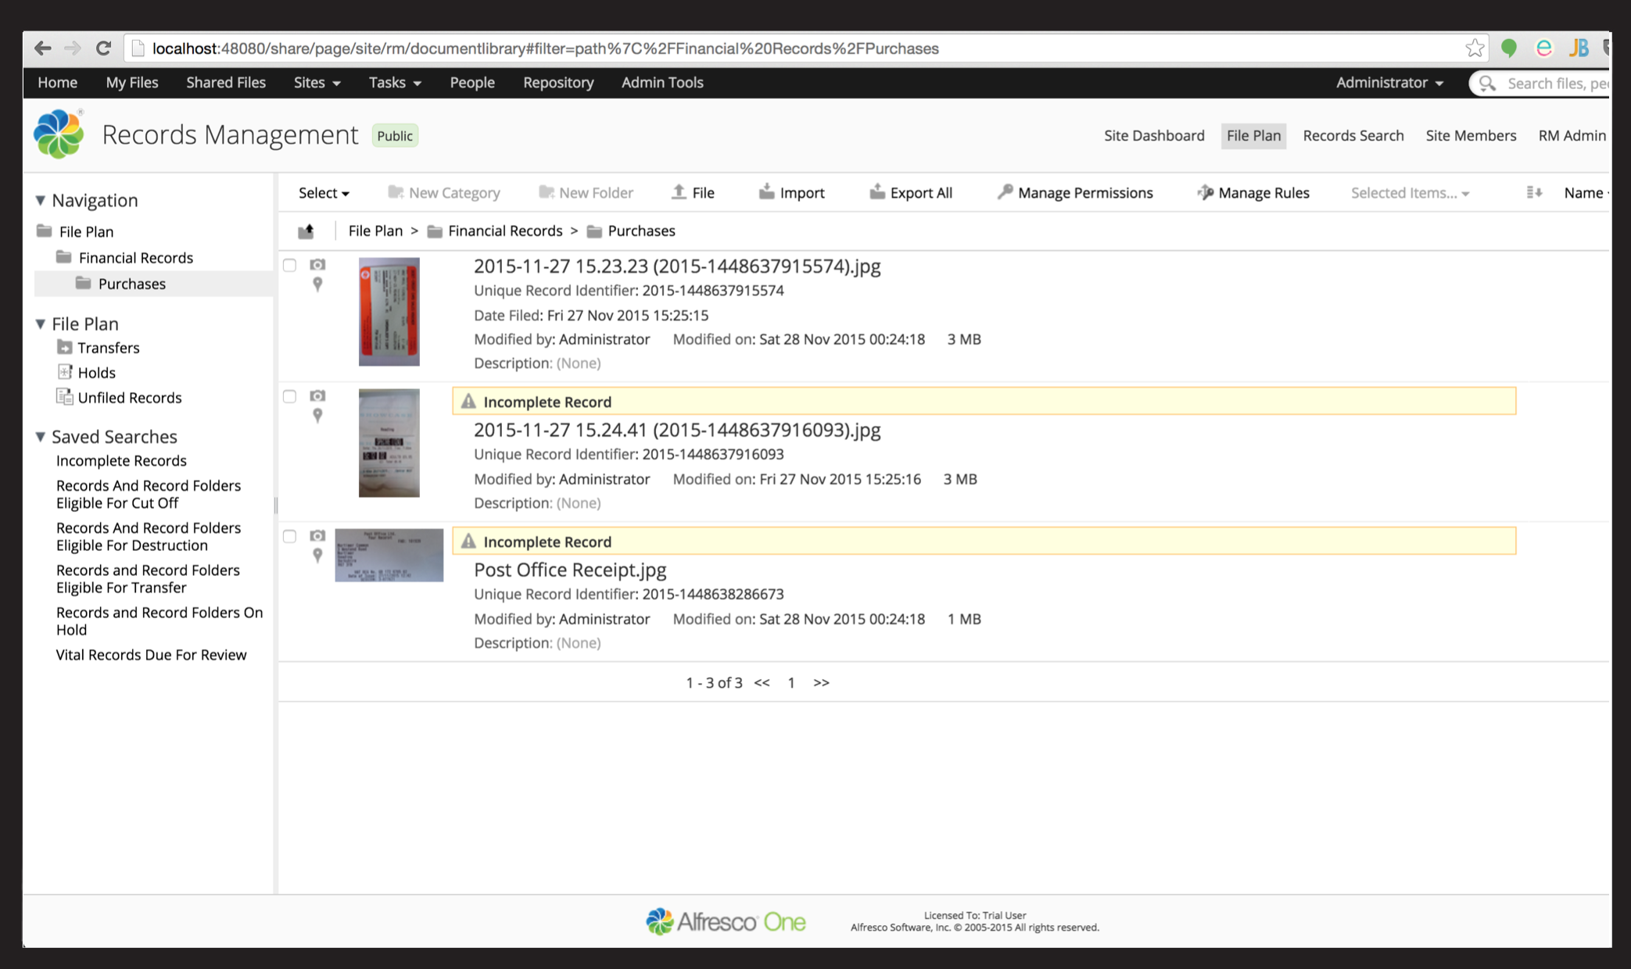

Slide 16
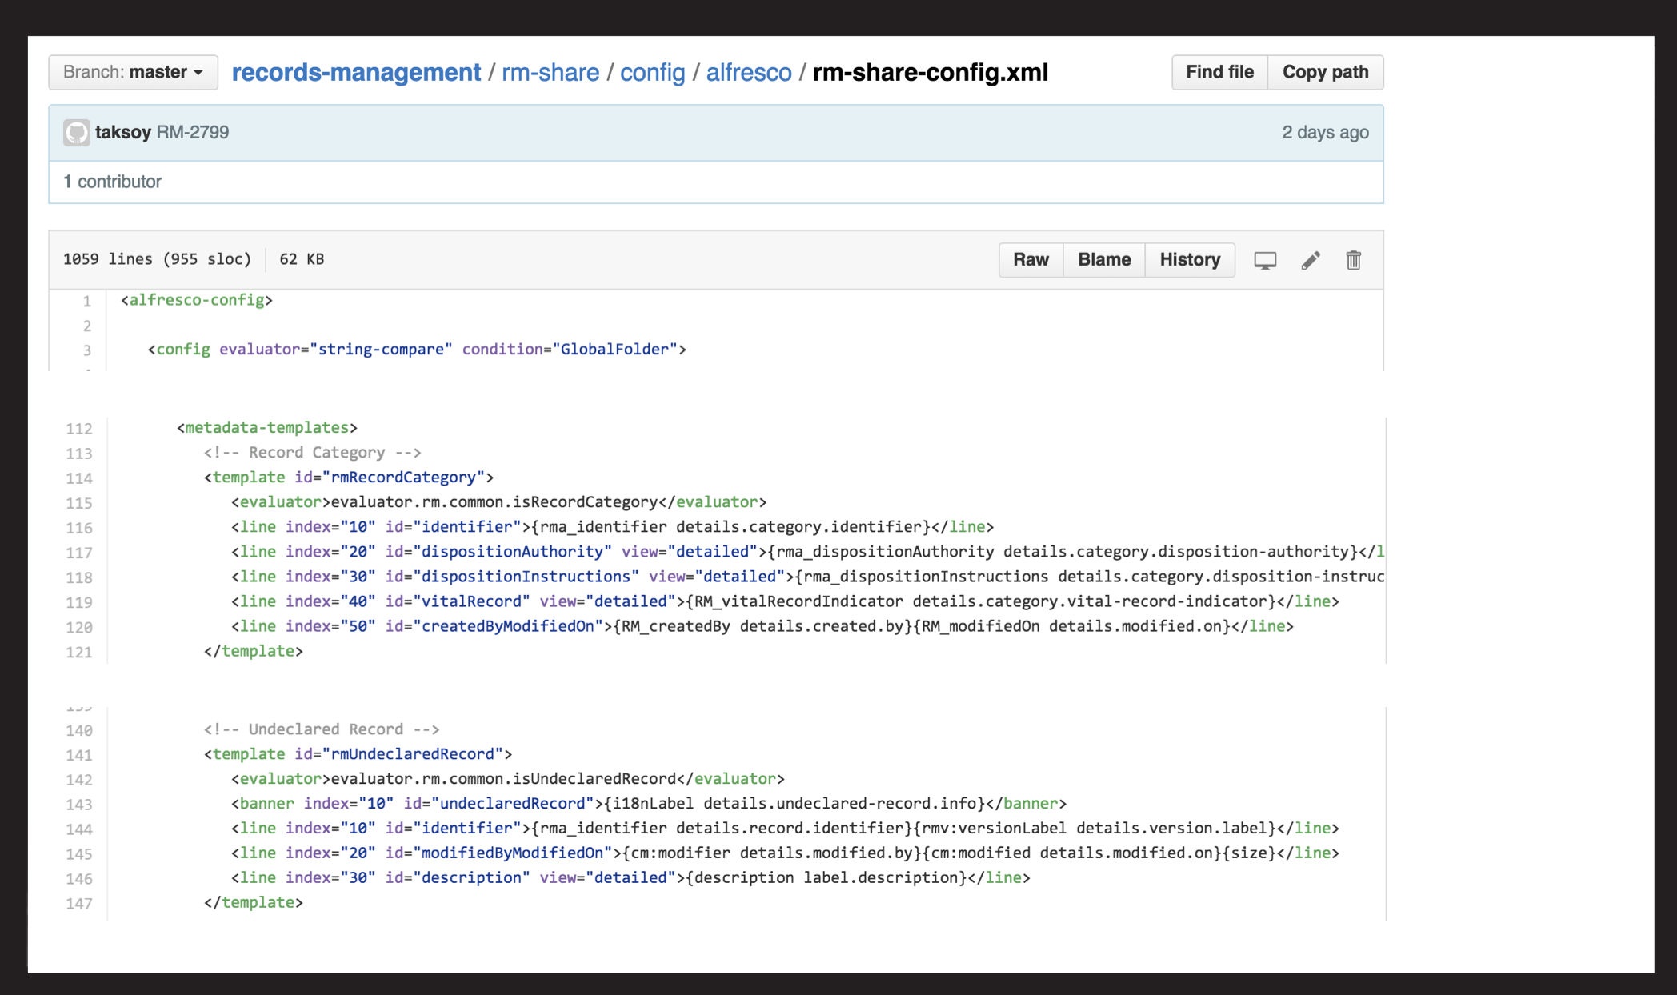

Slide 17
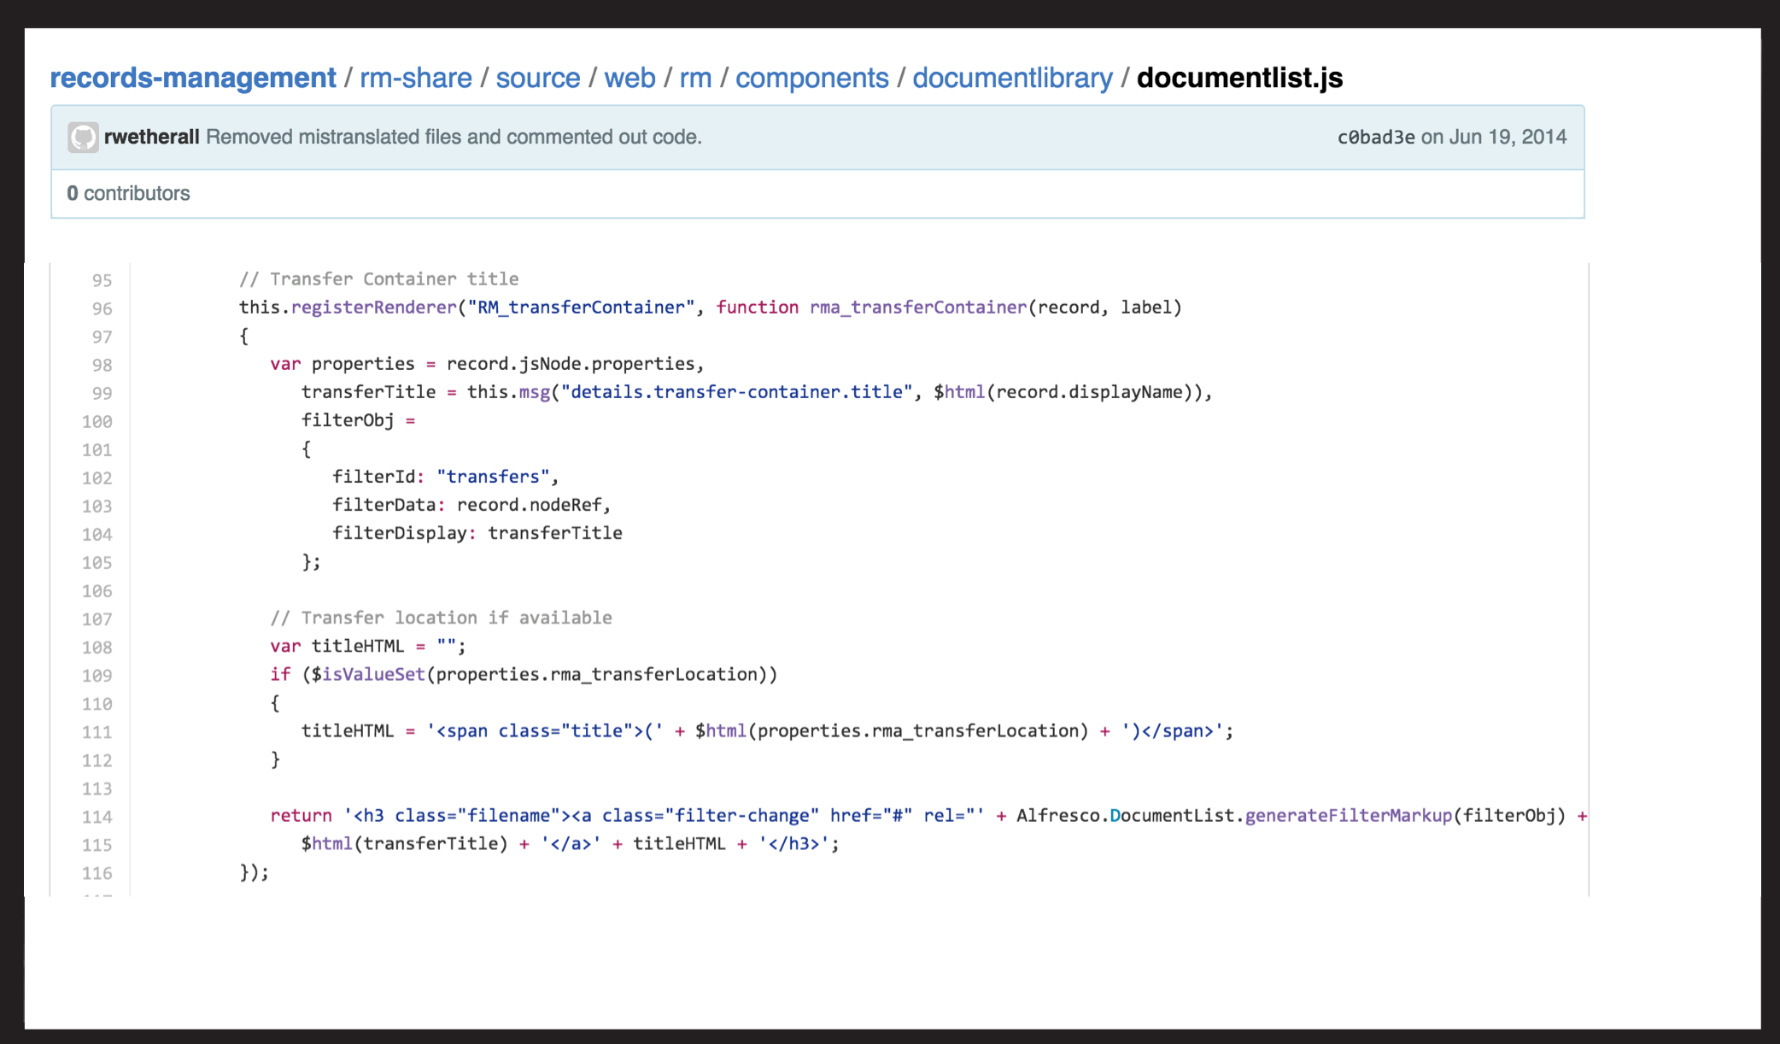

Slide 18
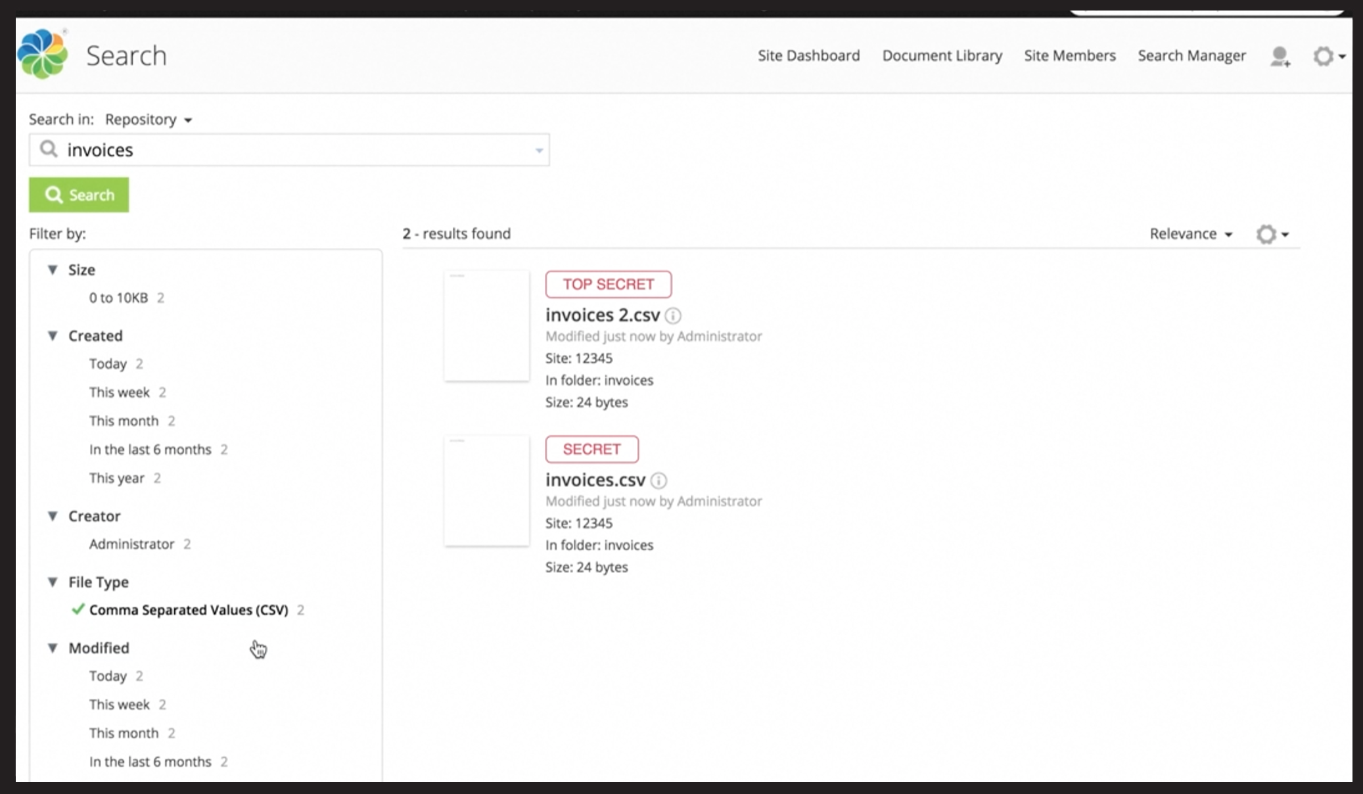

Slide 19
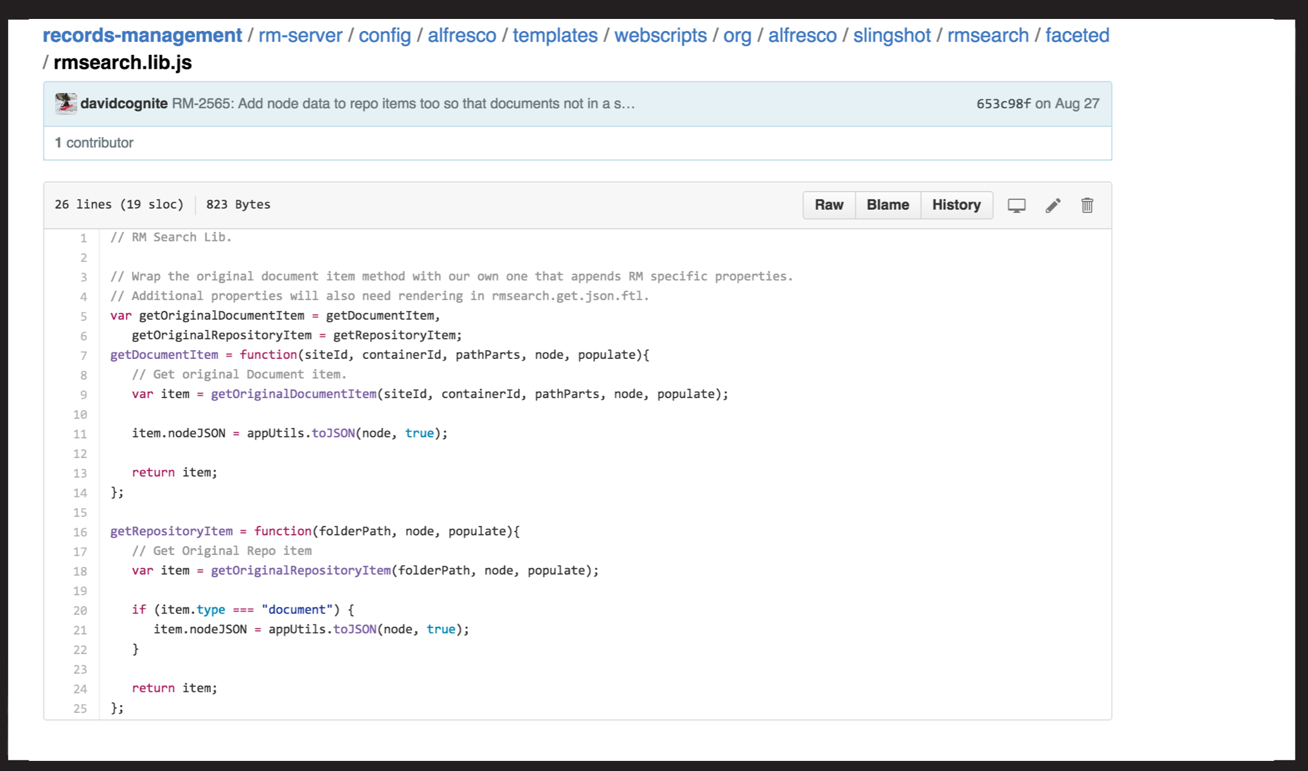

Slide 20
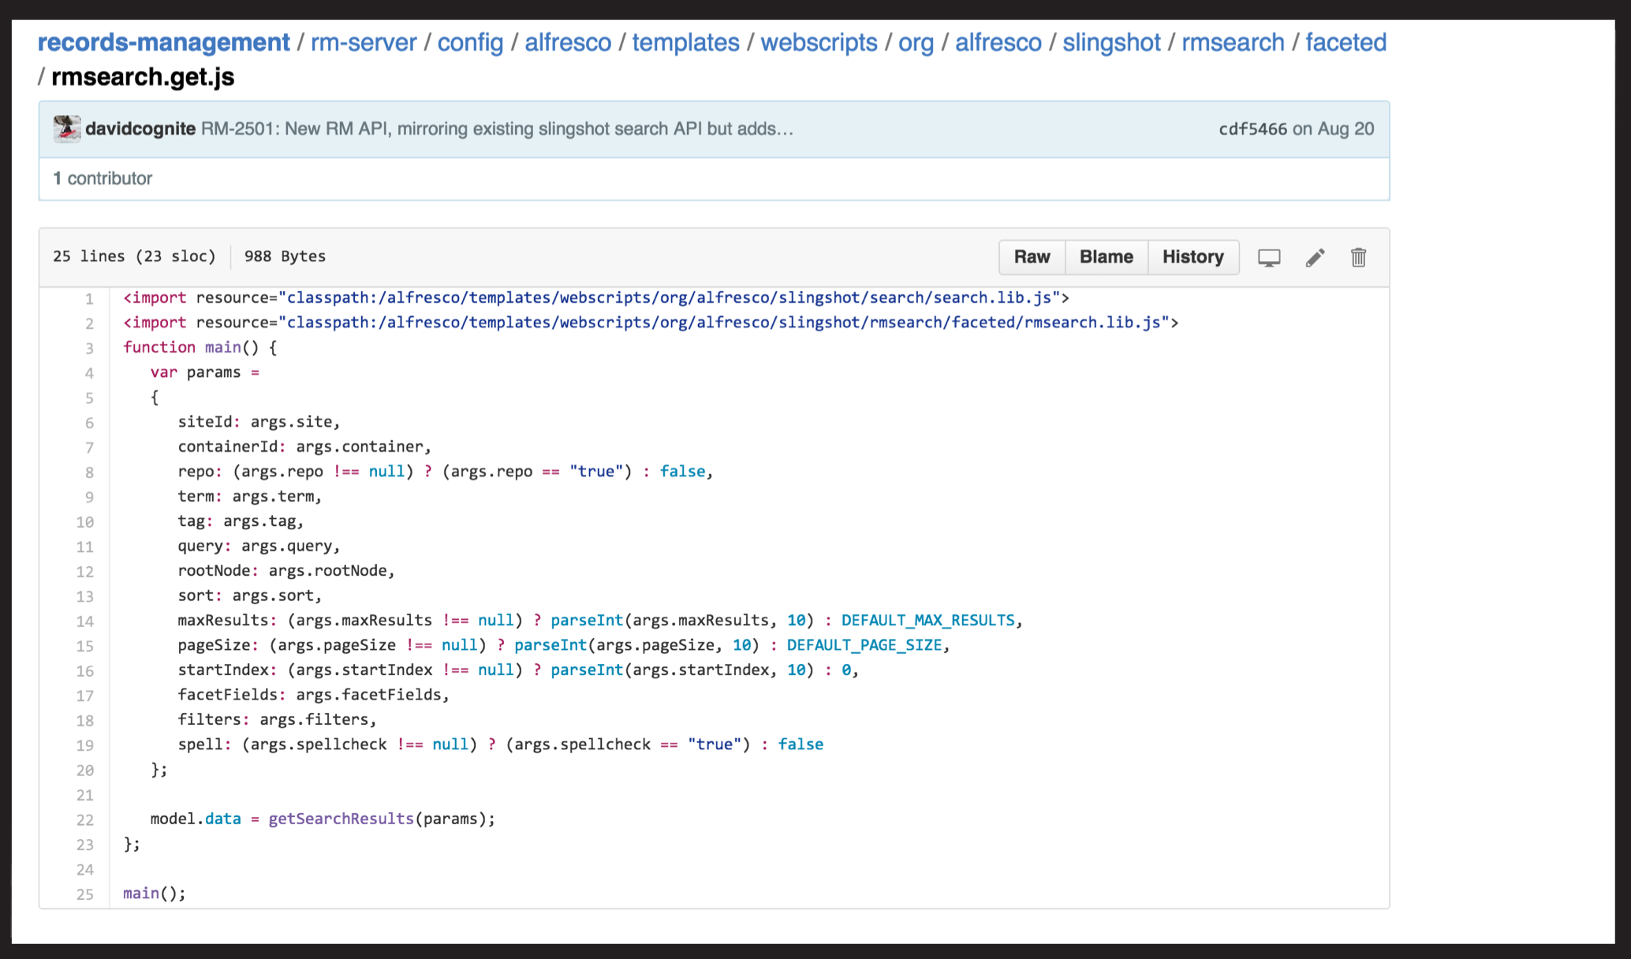

Slide 21
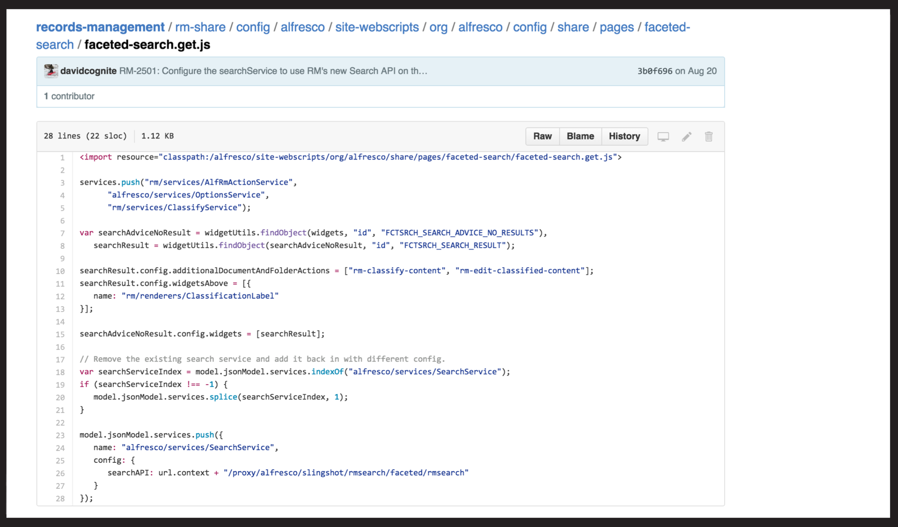

Slide 22
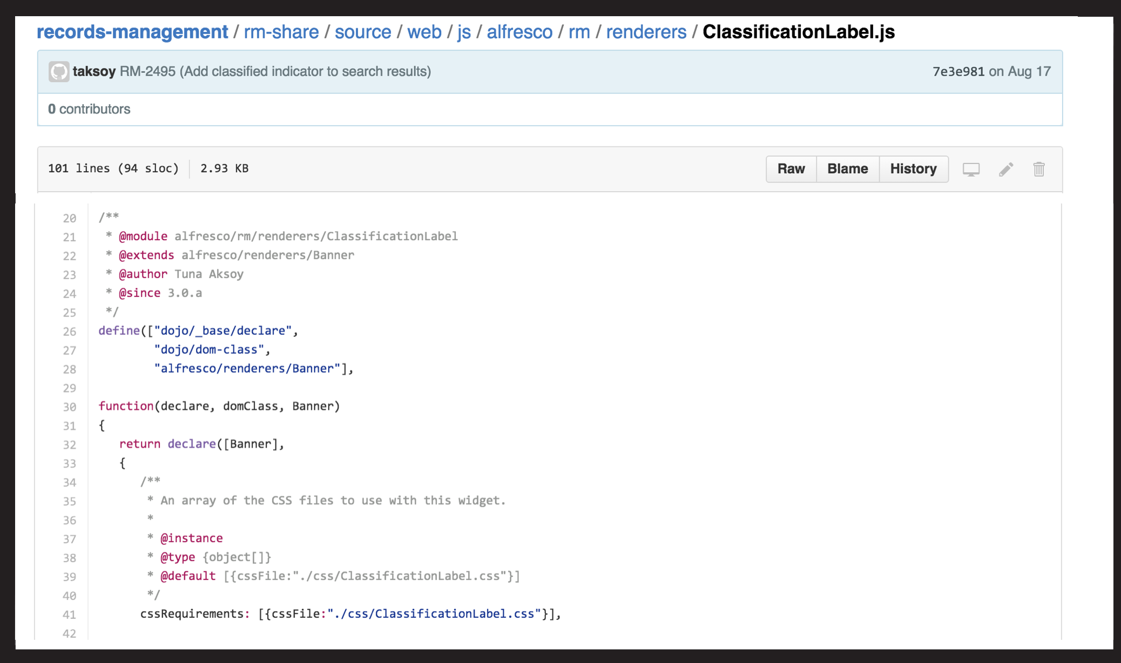

Slide 23
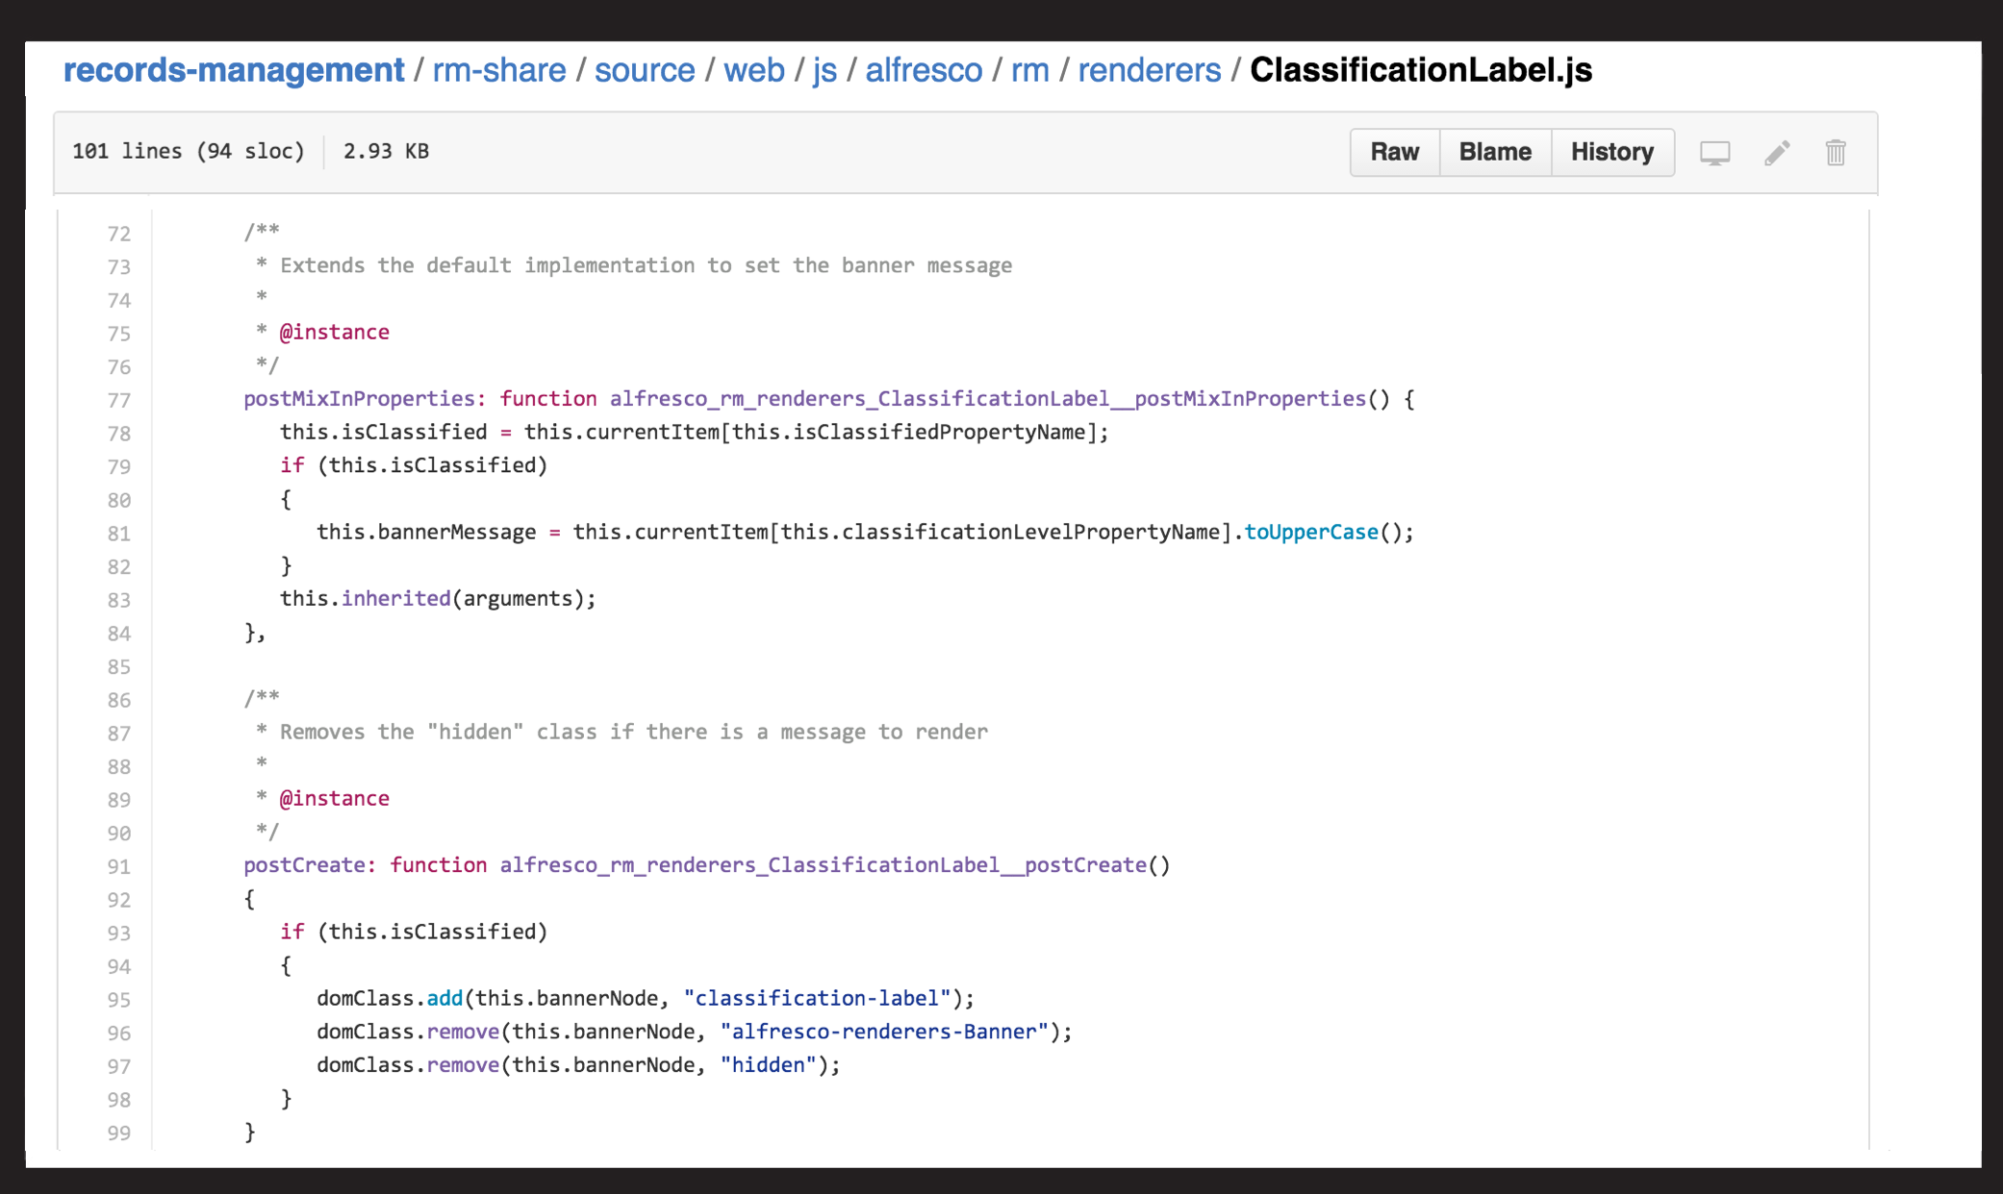

Slide 24
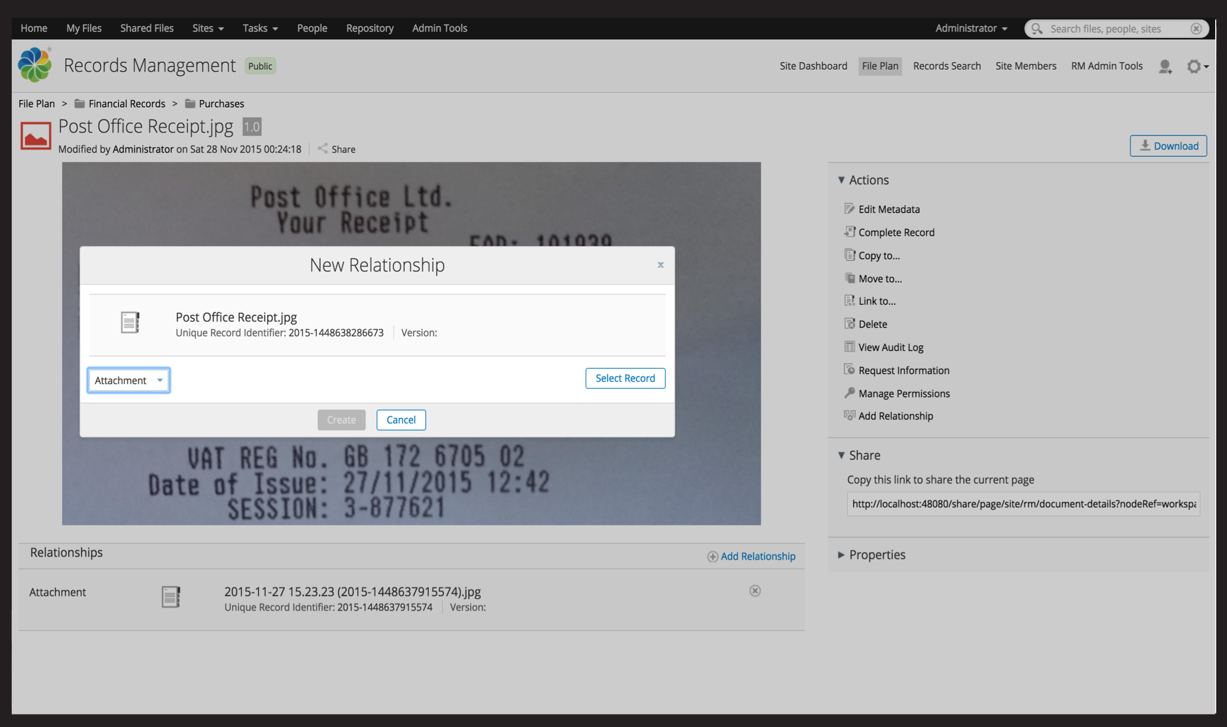

Slide 25
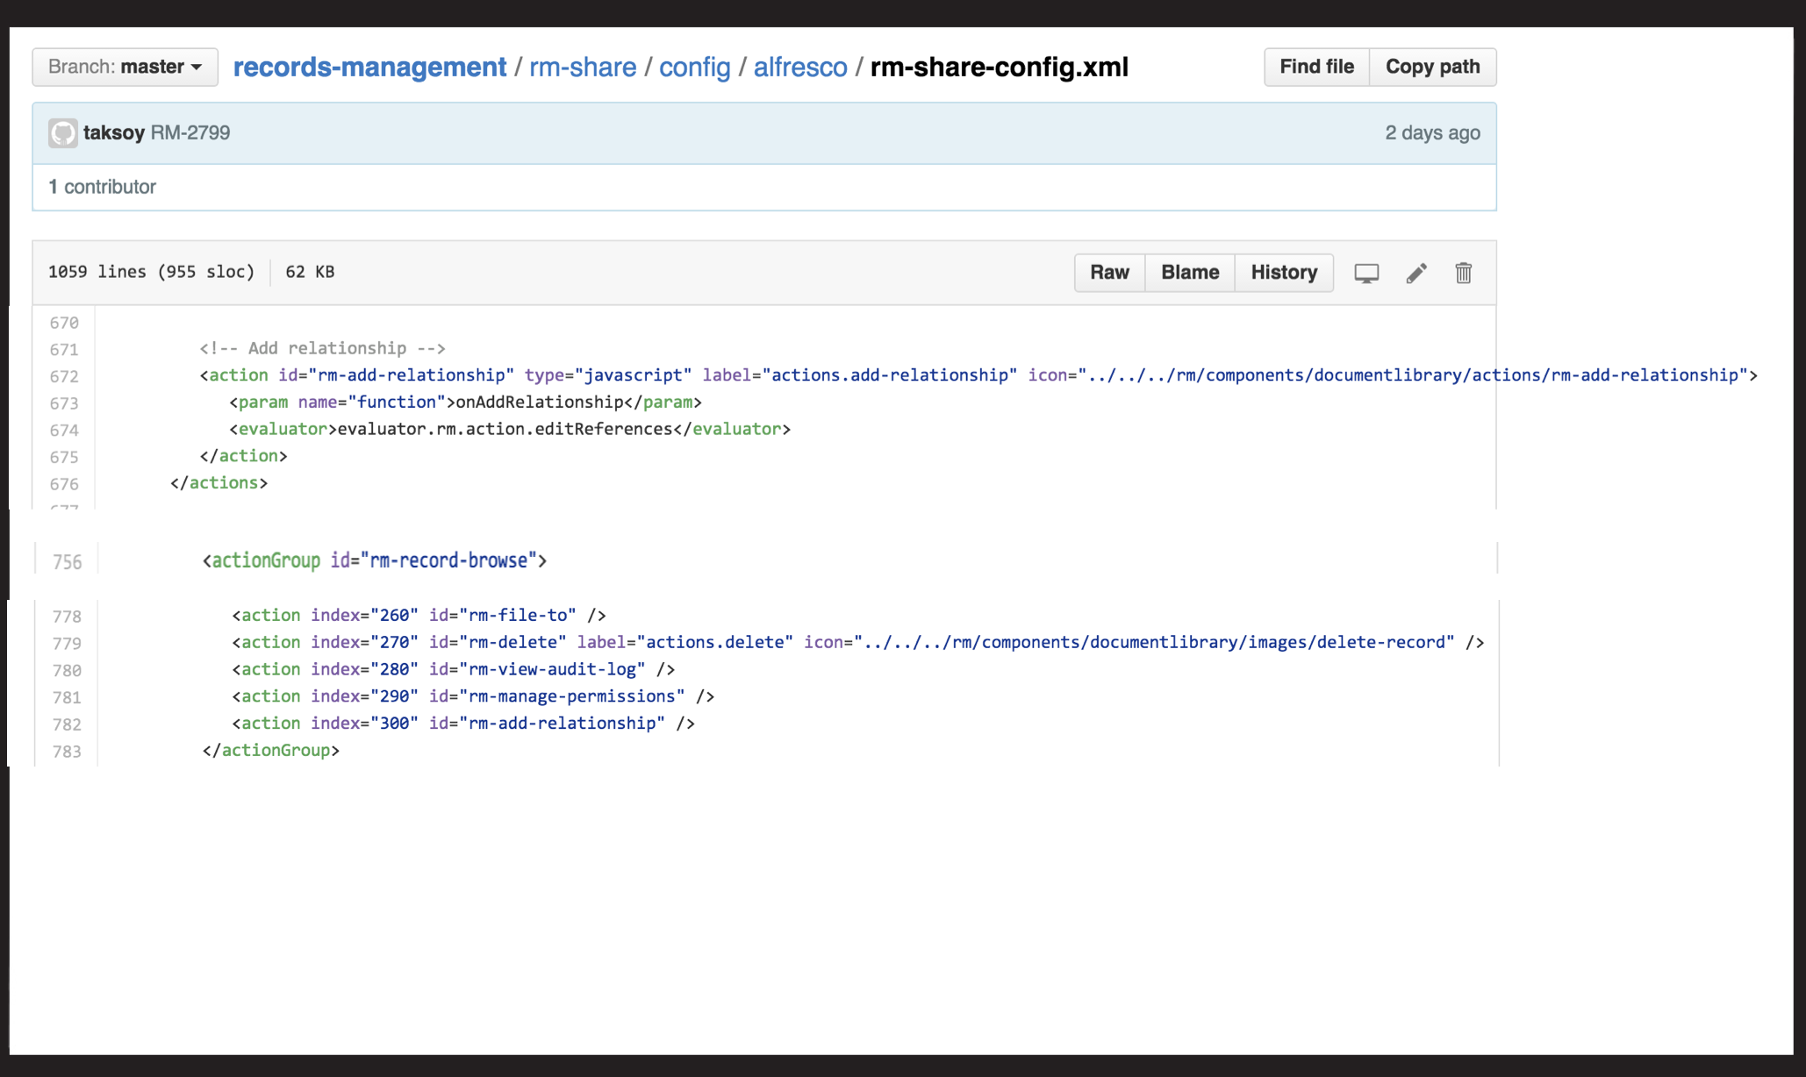

Slide 26

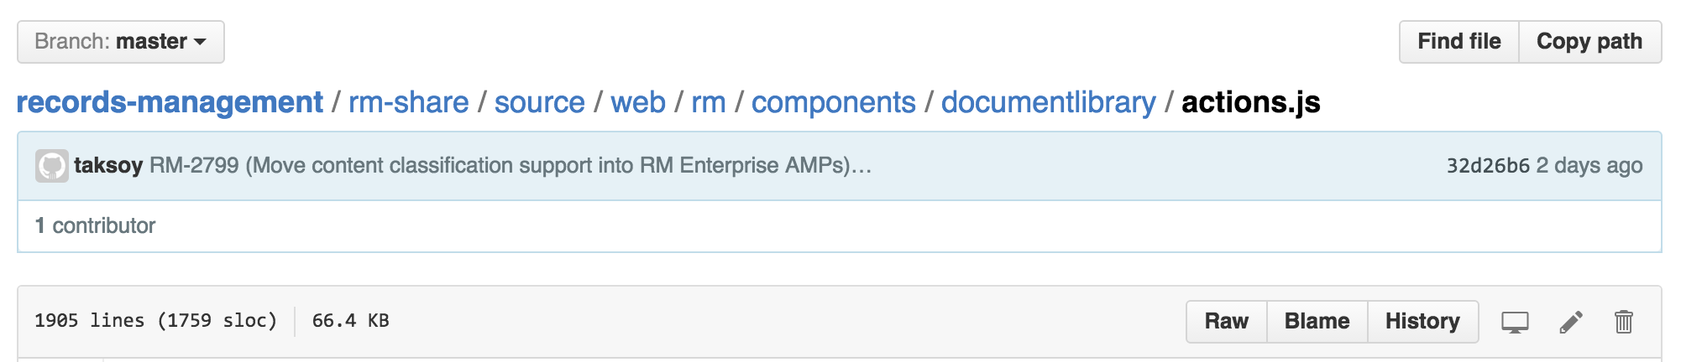
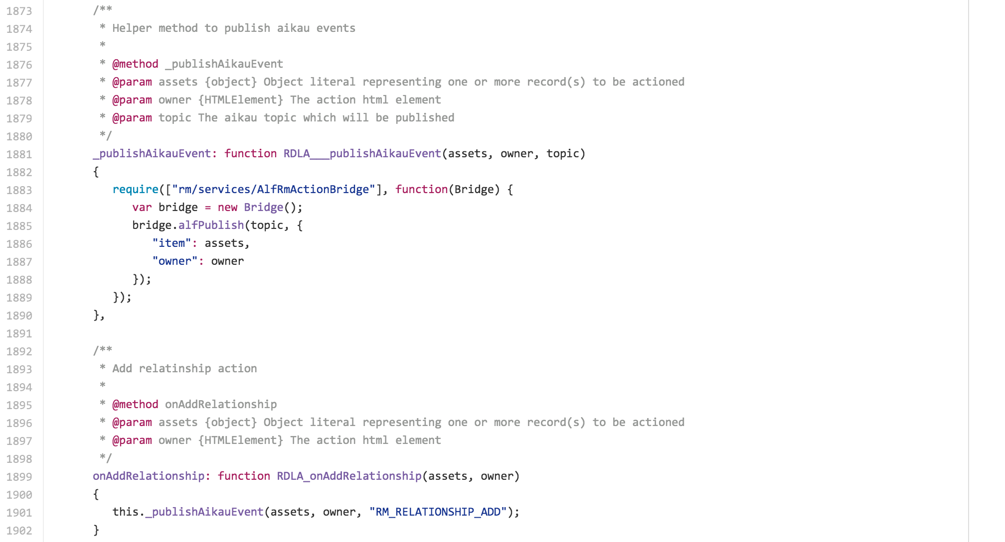

Slide 28
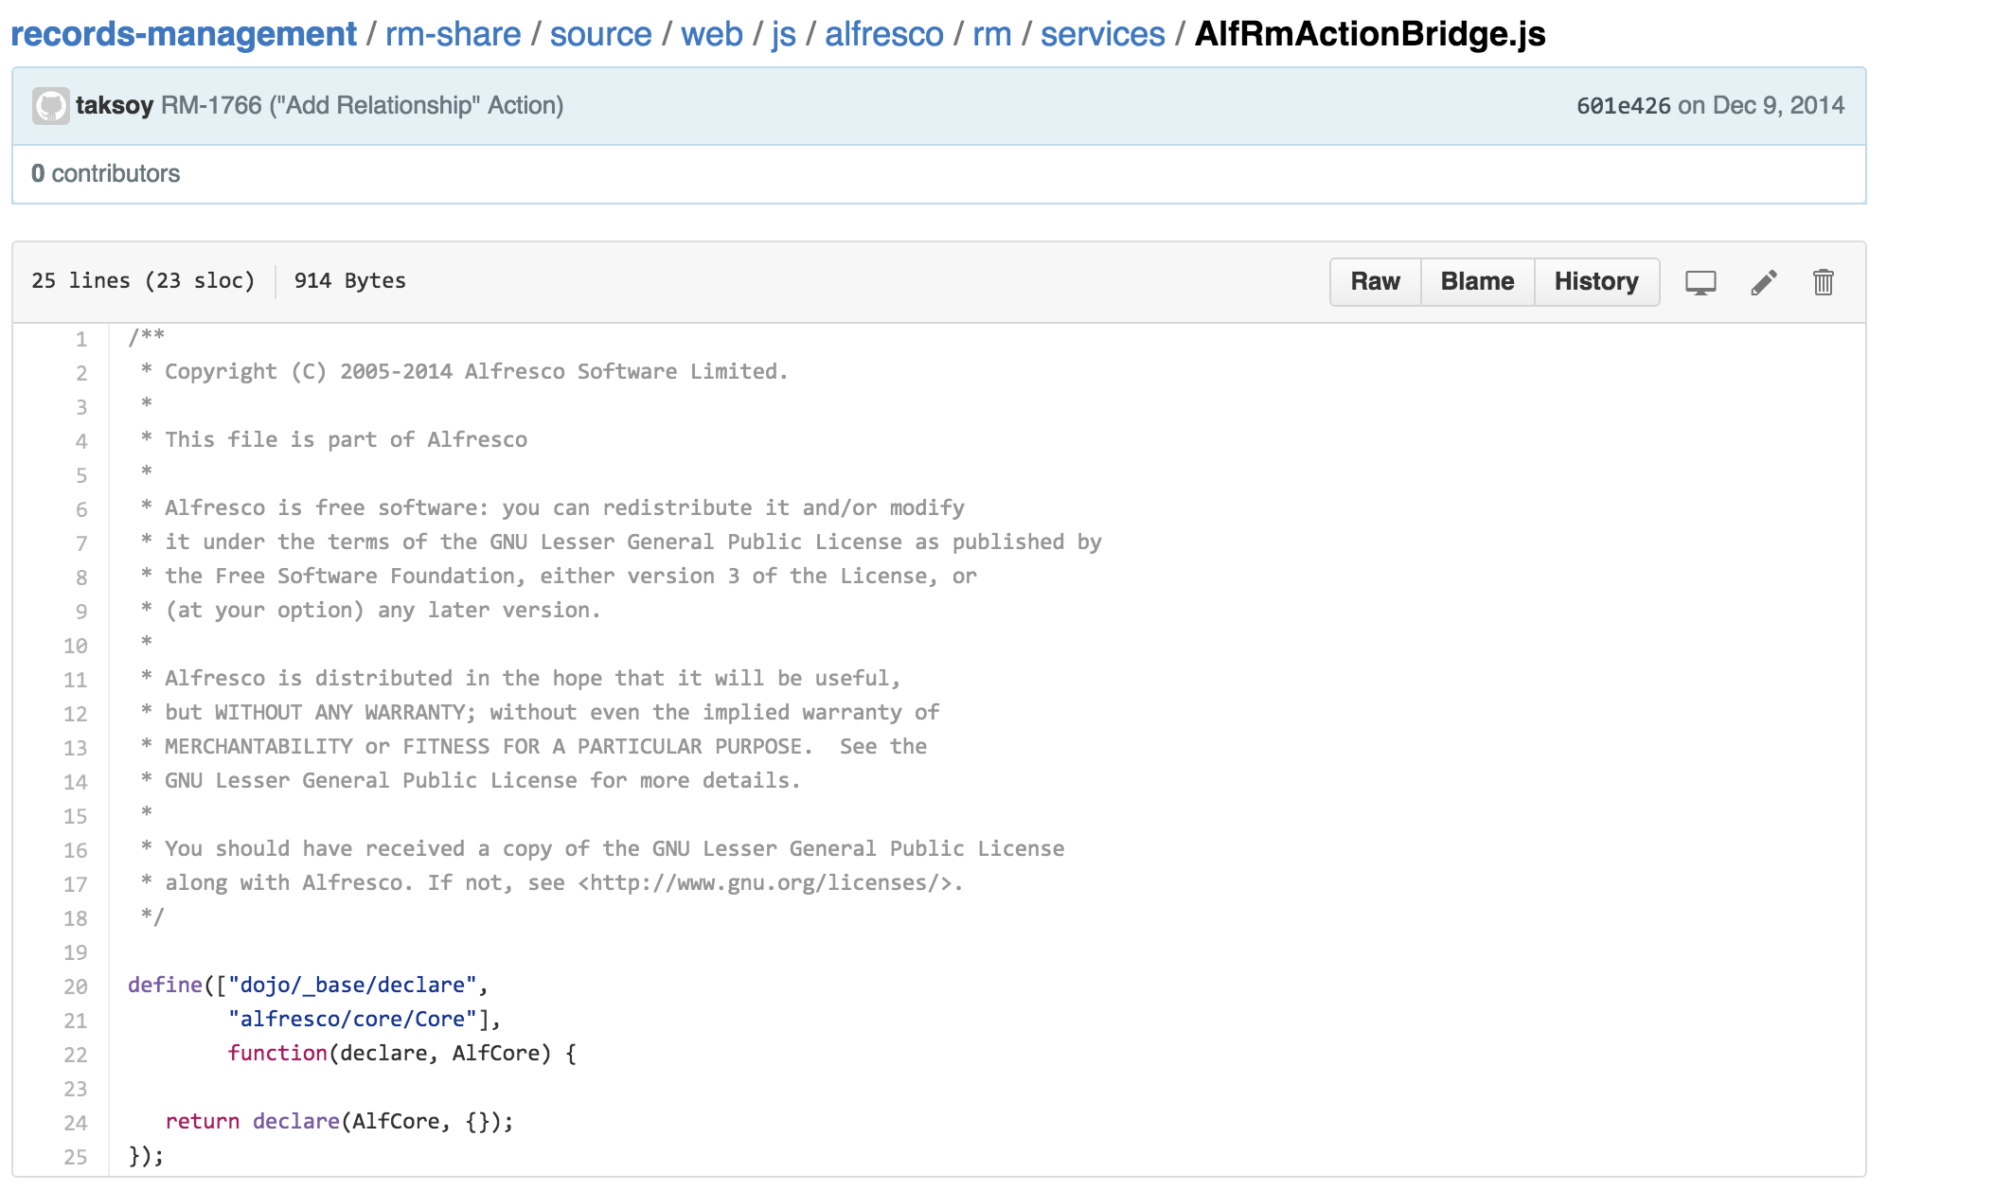

Slide 32
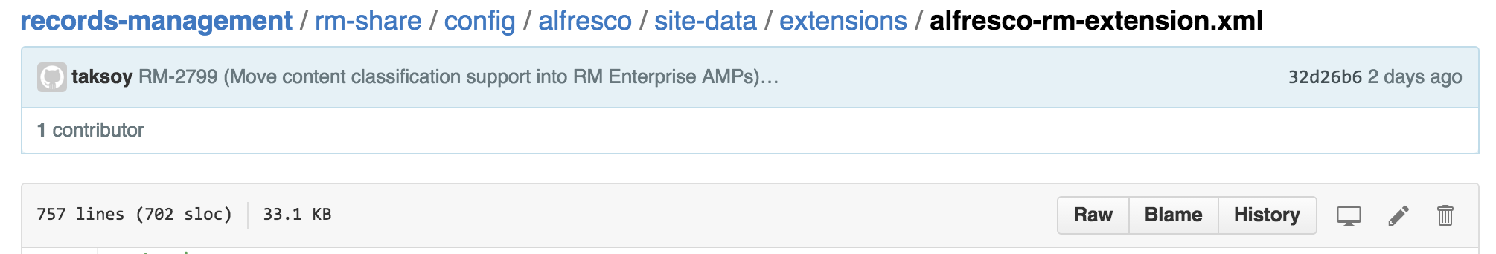
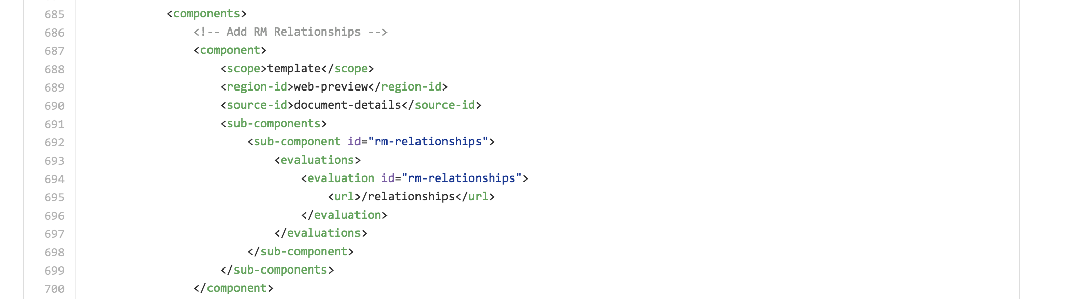

Slide 34
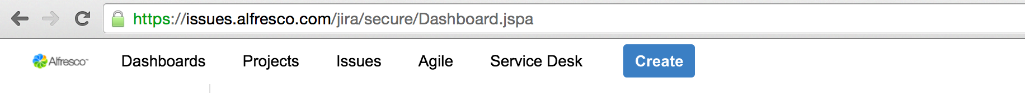

Slide 36
More Info:
http://docs.alfresco.com/5.1/concepts/dev-extensions-share.html

Slide 37

Questions?
@davidcognite

